Slide 1


SDP
LECTURE
Introduction to Design Patterns
Software Design Patterns
Diploma in IT
Year 2 (2024/25), Semester 4
1.1
Notes:
Hi everyone, welcome to the first lesson in the Software Design Patterns module! In this lesson, we will explain what design patterns are, and why we should care. Let me just say that knowledge of design patterns is one of those things that differentiates skilled software engineers from mere programmer noobs. So let’s get you some street cred, shall we?

Slide 2
What is a Design Pattern?
A re-usable solution to a recurring problem.
“Each pattern describes a problem which occurs over and over again in our environment, and then describes the core of the solution to that problem, in such a way that you can use this solution a million times over, without ever doing it the same way twice.”
- Christopher Alexander (1977)
Notes:
So first things first. A design pattern is a formal way of describing a solution to a recurring problem, and this solution is stated in a way that allows it to be reused for all instances of that problem. There are design patterns in all kinds of fields. For SDP, we are primarily concerned with software design patterns, so the problem we are looking at usually occur in large OO systems.
The concept of a design pattern was introduced by architect Christopher Alexander in 1977, who was a professor from University of California, Berkeley. The idea is to document the solution to common problems in a field, such as architecture or systems development, in a way that allows others to copy that solution when they encounter that problem in their own work. Not only that, the solution can be customized to fit the specific situation. In the case of object-oriented systems development, design patterns tell us how we should structure the classes and objects, but they have to be adapted to suit the problem context.

Slide 3
Patterns in Other Domains
Gaming
“Tank”, “DPS”, “Healer”,…
RTS, RPG, FPS,…
Network Architecture
Hub and spoke, grid, ring,…
Football (soccer)
4-4-2, 5-3-2,…
Powerful target man, speedy winger, creative midfielder,…
Notes:
If that’s difficult to understand, maybe examples from some other domains can help. I’m going to assume that most of you are || gamers, because I can see what you do in class during break. Or sometimes not during break. Anyway, you may have heard of some characters in certain games bring || referred to as a “tank” character, or a “dps” character, or a “healer” build. When I say a character is a tank, this immediately conveys some information to you – the character probably has a lot of hit points and/or armour, and can maybe attract or aggro enemies, because their job is to stand there and absorb hits while their friends do the killing. A DPS character, which stands for “damage per second”, is sometimes called a glass cannon because their purpose is to do as much damage in as short a time as possible, probably sacrificing hit points and survivability. There is a reason why these builds were given special names. Experience has shown that these builds are effective in many different games, so whenever you encounter the common problem of designing an effective party in a game, you would go back to these patterns. Similarly, game genres can also be thought of as design patterns. When a game is || classified as a real-time strategy game, or a role-playing game, or a first-person shooter, you immediately know some things about the game. The reason these game genres are given special names is because such games have been shown to be entertaining and satisfying to play, which solves the problem of making good games that you can sell and make money.
In || network architecture, several standard network configurations have been identified, such as hub and spoke, grid or ring configurations. They have their pros and cons, and a skilled network architect can pick or adapt the best configuration for a particular problem. And in || football, or soccer if you’re American, there are team formations like 4-4-2 or 5-3-2 that have been shown to be effective. There are even positions in the team where certain traits have been shown to be useful, such as a big powerful target man up front who can receive and keep the ball, a fast player on the wings who can run past defenders and cross, or someone in the middle of the field who can pass accurately. In fact, as long as a domain is mature and has had lots of people working on it, design patterns will naturally develop when good solutions are produced.

Slide 4
Benefits of Software Design Patterns
Leverage on years of experience
Tried and tested approaches to commonly encountered problems
Do not have to “re-invent the wheel”
Shared terminology improves communication
Improves system design for
Maintainability
Extensibility
Modification (refactoring)
Notes:
Let’s now list the benefits of studying software design patterns. Firstly, we are leveraging on years of experience to provide you with a way to solve problems using a proven solution. All those other system developers who have gone before you have done the hard work of trying out solutions, failing, refining their approaches, failing again, and so on, until they have come up with a recommended solution. Don’t bother to re-invent the wheel and commit the same mistakes that others have made, just take advantage of the shared wisdom of the ages to develop your systems correctly from the start.
Another benefit of software design patterns is || shared terminology. I could say that my character is rather weak at the start, but I will hang back and try to raise levels by getting the final hits that kills monsters, until my best attack that hits multiple units at the same time can help my team win. Or I can say that my carry will kill-steal to level up my AOE ult. Same meaning, significantly fewer words. When you communicate using patterns, you are doing more than just sharing lingo. By using a pattern name, you are communicating a whole set of qualities, characteristics and constraints that the pattern represents, so other developers can quickly understand precisely the design you have in mind.
The purpose of most software design patterns is to || improve system design in 3 aspects:
|| Maintainability – since design patterns that are understood by all will be easier to code and modify;
|| Extensibility – such that adding new classes does not impact existing classes; and
|| Modification – to handle the inevitable changes that will be required in the future. Related to this is code refactoring, which is the process of restructuring existing computer code without changing its external behavior. Refactoring is intended to improve nonfunctional attributes of the software, such as improving code readability, reducing complexity and improving extensibility.
So yeah, using design patterns is a good idea.

Slide 5
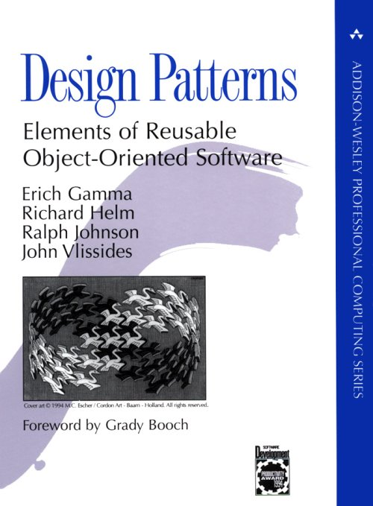
The Gang of Four Book
“Design Patterns: Elements of Reusable Object-Oriented Software” (1994)
Authors: Erich Gamma, Richard Helm, Ralph Johnson, John Vlissides
Known as the "Gang of Four” (GoF) book
Notes:
Our main reference is a book called “Design Patterns: Elements of Reusable Object-Oriented Software”, published in 1994. This is the so-called bible of software design patterns, and the patterns described here have been used countless times in all sorts of systems. This has also been called the || Gang of Four book since it has 4 authors. If you study design patterns, you have to know about the Gang of Four book.

Slide 6
Types of Patterns in Software
23 Design Patterns proposed in GoF book
Creational patterns
Constructing objects
Abstract Factory, Builder, Factory Method, Prototype, Singleton
Structural patterns
Controlling the structure of a class, e.g., affecting the API or the data structure layout
Adapter, Bridge, Composite, Decorator, Façade, Flyweight, Proxy
Notes:
The Gang of Four book proposed 23 different design patterns, which they broadly categorized into 3 categories based on their purpose. The first set of patterns are called || creational patterns, and the purpose of these patterns is to handle the creation of objects. The design patterns that fall under this category are || abstract factory, builder, factory method, prototype and Singleton. For example, the abstract factory design pattern specifies an interface for concrete factory classes, which are classes in charge of creating objects of another class called a product. The idea is that you pass the specifications of the product to the factory class, and the factory class will then create and return that object. Another example is the Singleton pattern, which creates an object that is the single copy of a class in the program.
|| Structural patterns are those that control how the code is organized so that the program is easier to extend and maintain overall. Under this category are the || adaptor, bridge, composite, decorator, façade, flyweight and proxy patterns. For example, the adapter pattern is like our power adapter that converts, say, an American 2-pin plug to our Singaporean 3-pin format, but in this case, it will convert one interface to another. Another example is the decorator pattern, which is a recursive pattern that is useful when you have an object that you want to attach new features to during runtime, such as when you are adding toppings to a pizza.

Slide 7
Types of Patterns in Software
Behavioral patterns
Deal with how objects behave
Chain of Responsibility, Command, Interpreter, Iterator, Mediator, Memento, Observer, State, Strategy, Template Method, Visitor
Many other design patterns have since been proposed
Notes:
The third category is || behavioural patterns, which handle how objects behave. The Gang of Four book proposed 11 behavioural design patterns, which are || chain of responsibility, command, interpreter, iterator, mediator, memento, observer, state, strategy, template method and visitor. For example, you may have used the Iterator design pattern in C# to go through every element in a collection like a List or Dictionary. In fact, every time you use “foreach” to iterate through any standard collection in C#, you are actually reaping the benefits of the Iterator design pattern.
Like I said, the original Gang of Four book proposed 23 design patterns, and most if not all of them are still widely used today, although they have usually been modified or refined since they were first introduced in 1994. Furthermore, || many authors have proposed other design patterns since then. In SDP, we don’t have time to go into all 23 design patterns, but we will go through several of them. Based on the example set by the Gang of Four, all software design patterns are expressed in a similar way, with a definition, a class diagram, and a description of when they should be applied. So a major learning outcome of the SDP module is to give all of you the ability to look up and learn other design patterns on your own.

Slide 8
Summary
What are design patterns?
Benefits of design patterns
Notes:
So that was our quick introduction to design patterns. We explained what they are, and also why using design patterns helps us make better systems that are easier to maintain, extend and modify, and also helps us communicate our ideas more efficiently and concisely. Ultimately, design patterns help us make better software, which is pretty much the whole point, isn’t it?

